Slide 1

BUG TRACKING SYSTEM
Bug Tracking, Issue Tracking, and Project Management

Slide 2

THE TEAM
Aditi Mishra
Aditya Goenka
Ananya Joshi
Fatehpreet Singh
Kaustav Ganguly
Payal Gandhwani
Pooja Patel
Vedika Hirpathak

Slide 3

What is
BUG TRACKING SYSTEM
The Bug Tracking System project is a comprehensive software solution designed to streamline the process of identifying, documenting, tracking, and resolving issues or bugs within a software development or IT environment. This project aims to enhance the overall software quality, improve collaboration among team members, and provide valuable insights into the software development lifecycle.

Slide 4
Objectives
Issue Identification: The system allows developers, testers, and other stakeholders to report and identify issues or bugs in the software. This can include functionality problems, crashes, security vulnerabilities, or any other undesirable behavior.
Issue Documentation: It provides a structured way to document each identified issue. This includes details such as the issue's description, severity, priority, steps to reproduce, environment information, and any associated files or logs. Proper documentation is essential for effective issue resolution.
Issue Tracking: The system keeps a history of all reported issues and their status, enabling team members to track the progress of issue resolution. This ensures that issues are not overlooked and are addressed in a timely manner.

Slide 5
Quality Improvement: By identifying and addressing bugs and issues, bug-tracking systems contribute to improving the overall quality and reliability of the software. This, in turn, enhances the user experience and reduces the risk of post-release problems.
Reporting and Metrics: Bug tracking systems often provide reporting and analytics features. Teams can generate reports on the status of issues, bug trends over time, and other metrics to assess the quality and progress of the software development process.
Change Management: In addition to tracking bugs, bug-tracking systems can also be used to manage and track changes, enhancements, or new features requested for the software. This helps in planning and prioritizing development efforts.
Audit Trail: The system will maintain a detailed audit trail of all actions taken within the system, providing transparency and compliance with regulatory requirements in certain industries.

Slide 6

Table of
CONTENTS
01
02
03
04
Features of Project
Consists of application features used throughout the project
Things we learned
Consists of technologies as well as soft skills gained while completion of project
A look through
Consists of snapshots of project UI
Benefits of the project
Consists of all the advantages and benefits of the project

Slide 7

FEATURES OF BUG TRACKING SYSTEM
A Bug Tracking System project has a wide range of features to effectively manage the identification, tracking, and resolution of issues or bugs in a software development process. Some of which are:

Slide 8
Features
User Registration and Authentication:
User registration and account management.
Role-based access control to define user permissions.
Issue Creation and Management:
Easy-to-use issue creation forms with customizable fields.
Categorization of issues by type, severity, priority, and status.
Attachment support for adding screenshots, logs, and other relevant files.
Bulk issue creation for similar problems or feature requests.

Slide 9
Issue Tracking and Workflow:
Real-time issue tracking with status updates and timestamps.
Customizable workflow for issue lifecycle management.
Automated email notifications for status changes and assignments.
Issue Prioritization:
Priority levels (e.g., low, medium, high, critical) for issue classification.
Severity levels (e.g., minor, major, blocker) for impact assessment.
Change and Release Management:
Tracking of software changes, enhancements, and new feature requests.
Release planning and version management.

Slide 10
Search and Filter Capabilities:
Advanced search options to find issues based on various criteria.
Saved searches for quick access to frequently used filters.
Workflow Customization:
Customizable workflows to define the stages an issue goes through.
Automation of repetitive tasks or status changes.
Data Import and Export:
Importing existing issue data from other systems.
Exporting issue data for backup or migration purposes.

Slide 11
LEARNINGS THROUGH THE PROJECT
The key learnings from this project encompass both technical and managerial aspects. Next slide contains what we learned while developing this project.

Slide 12


Technical
For developing this project, a number of technologies were implemented.
LEARNINGS
UI/UX
For designing the UI/UX the technologies used are: HTML, CSS, JavaScrpit and Bootstrap.
Backend
Backend is developed with the help of Java.
Database
For controlling the database, MySQL is made use of.

Slide 13
HTML
HTML stands for HyperText Markup Language.
It is a standard markup language for web page creation.
It allows the creation and structure of sections, paragraphs, and links using HTML elements (the building blocks of a web page) such as tags and attributes.

Slide 14
CSS
CSS stands for Cascading Style Sheets.
It plays a crucial role in web development by allowing developers to control the layout, appearance, and design of web pages.
It provides a set of rules and styles that determine the colors, fonts, spacing, layout, and other visual aspects of a webpage.

Slide 15
JAVASCRIPT
JavaScript is a versatile and widely used programming language primarily used for web development.
It allows developers to create dynamic and interactive web pages by adding behavior, functionality, and interactivity to HTML and CSS.
JavaScript is executed in web browsers, making it a client-side scripting language, but it can also be used on the server-side with technologies like Node.js.

Slide 16
BOOTSTRAP
Bootstrap is a popular and widely used front-end framework for web development.
It provides a collection of pre-designed, responsive, and customizable HTML, CSS, and JavaScript components and styles.
Developers use Bootstrap to create modern and visually appealing websites and web applications effectively.

Slide 17
JAVA
Java is a versatile and widely used language in web application development, both on the server-side and the client-side, offering a robust ecosystem of tools, frameworks, and libraries that enables us to build scalable, secure, and feature-rich web applications for a variety of industries and use cases

Slide 18
For server side web-development
Servlets: Java Servlets are server-side components that handle HTTP requests and generate dynamic web content. Servlets are the foundation of Java-based web applications.
JavaServer Pages (JSP): JSP is a technology that allows us to embed Java code within HTML pages. It enables the creation of dynamic web pages by combining HTML templates with Java logic.
Web Servers and Application Servers: Java web applications are typically deployed on web or application servers such as Apache Tomcat, Jetty, WildFly, or Apache TomEE.

Slide 19
MYSQL
MySQL is widely used in web development as a relational database management system (RDBMS) to store, retrieve, and manage data for web applications.
It provides a robust and scalable solution for storing and managing structured data.
It offers powerful features for data storage, retrieval, and management, making it a preferred choice for web applications, e-commerce platforms, content management systems, and a wide range of software projects.

Slide 20
Here's how MySQL was used in this project:
Data Storage: MySQL is used to store structured data such as user information, project details, bug details, etc.
Dynamic Content: Bug Tracking System requires dynamic content that can change based on user interactions or data updates. MySQL is used to store this dynamic data, allowing web applications to retrieve and display information as needed.
User Authentication: MySQL is commonly used to store user account information, including usernames, passwords (hashed and salted for security), and other user-related data.
Scalability: MySQL supports scalable architecture configurations, allowing web developers to scale their applications as traffic and data grow. Techniques like database sharding and replication can be used for high availability and performance.

Slide 21


Manegerial
LEARNINGS
Managerial skills are crucial in team projects, as they facilitate effective collaboration, communication, and overall project success. They are essential for planning, organizing, coordinating, and leading efforts to achieve over all goals and objectives.

Slide 22
Communication
Teamwork
Clear and effective communication is vital in team projects. Team members need to convey ideas, updates, and feedback concisely and actively listen to others.
Being a team player involves cooperating, collaborating, and valuing the contributions of others. Team members should be willing to help and support their colleagues.

Slide 23
Conflict Resolution
Problem-Solving
The ability to identify challenges, analyze problems, and work collectively to find solutions is crucial in overcoming project obstacles.
Conflict can arise in team projects. Soft skills for conflict resolution involve addressing disagreements in a constructive and respectful manner to find mutually acceptable solutions

Slide 24
A LOOK THROUGH THE PROJECT
This part gives a peek throughout the project by showing snapshots of the project UI and code snippets

Slide 25
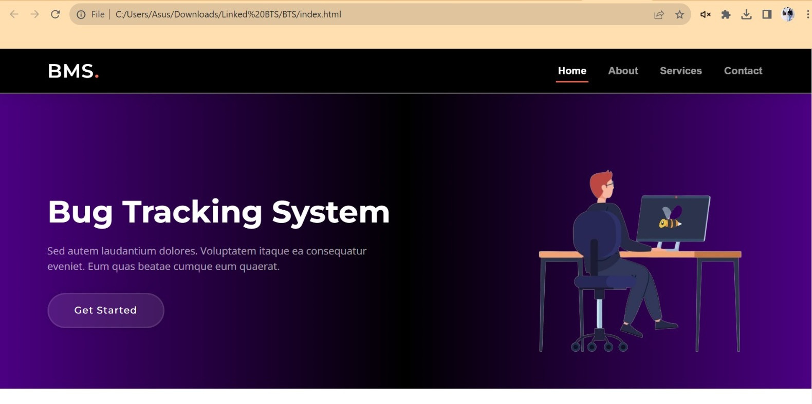

Slide 26
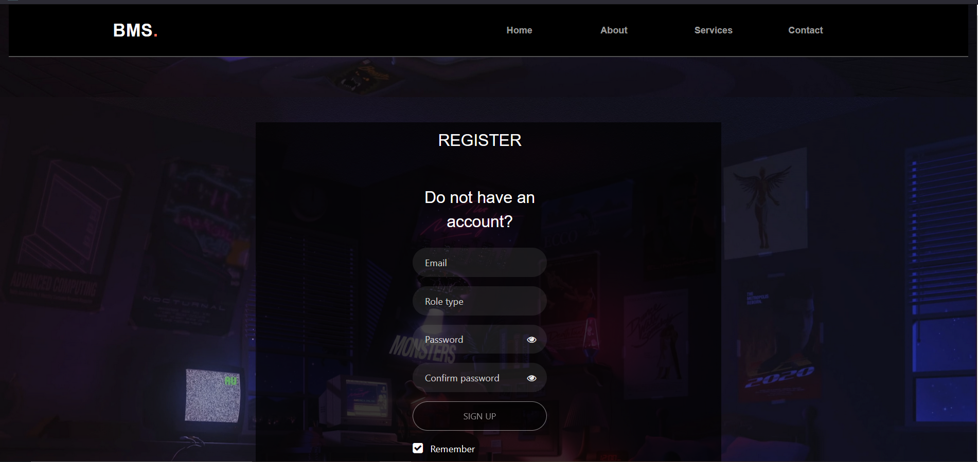

Slide 27
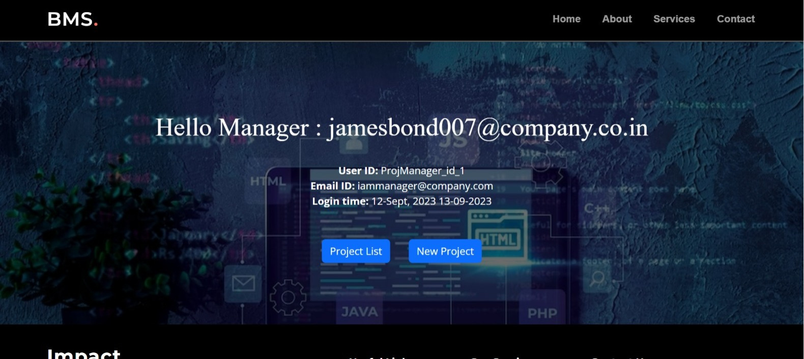

Slide 28
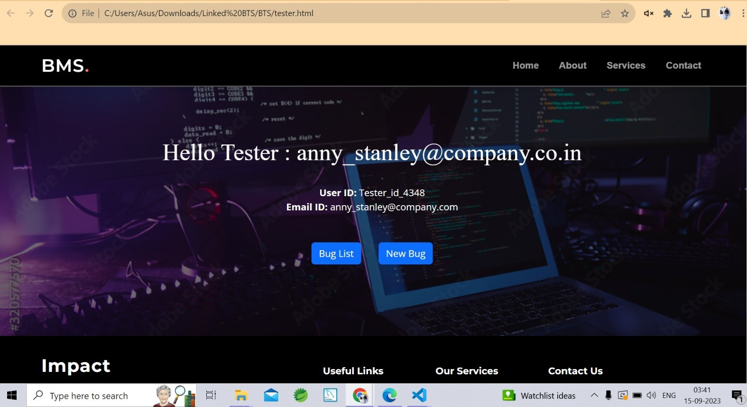

Slide 29
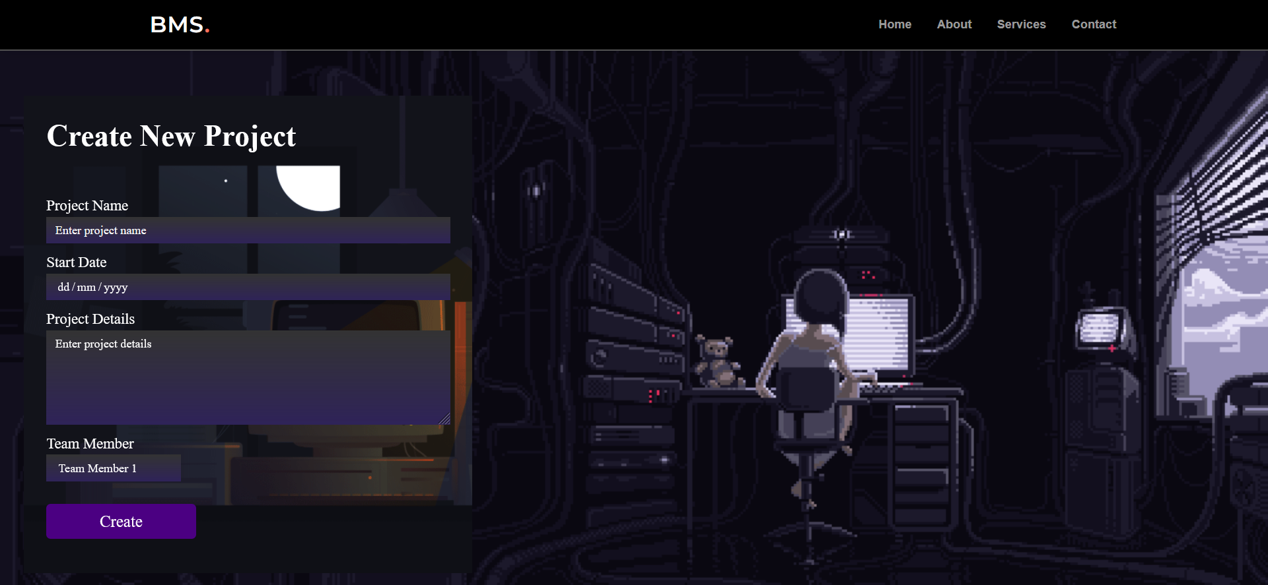

Slide 30
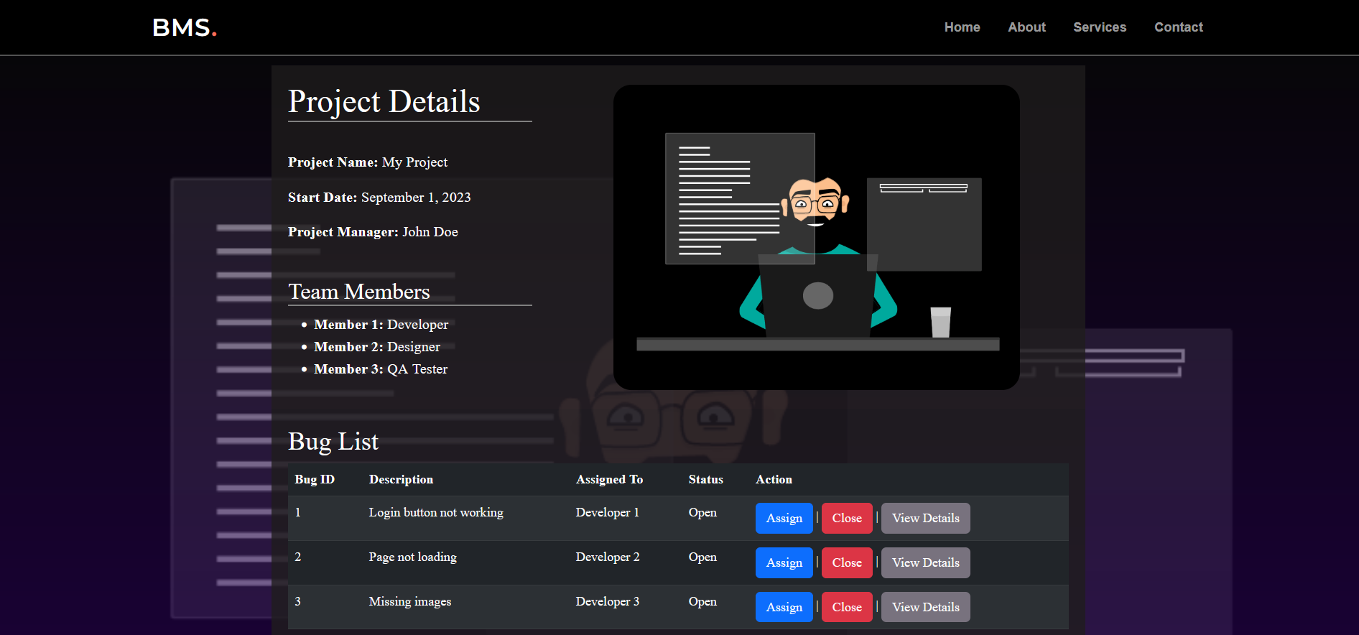

Slide 31
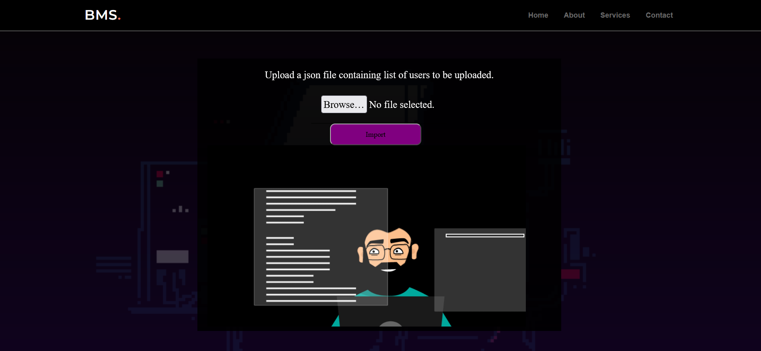

Slide 32
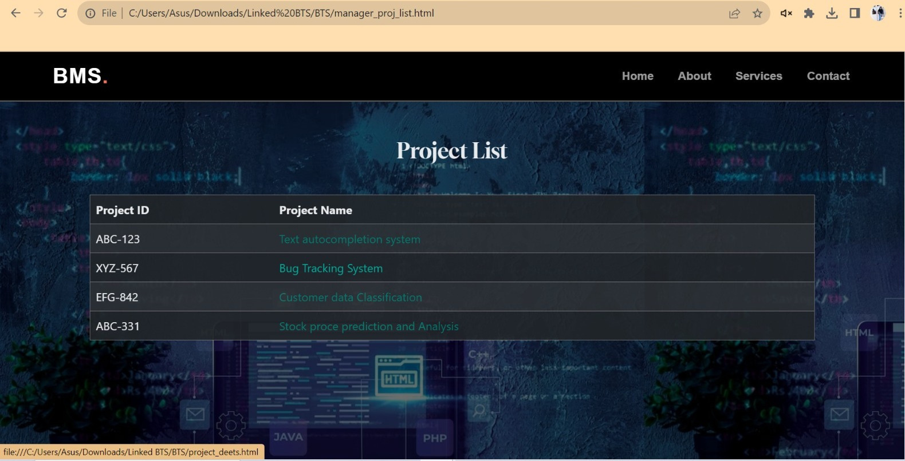

Slide 33
Further slides contain some code snippets

Slide 34
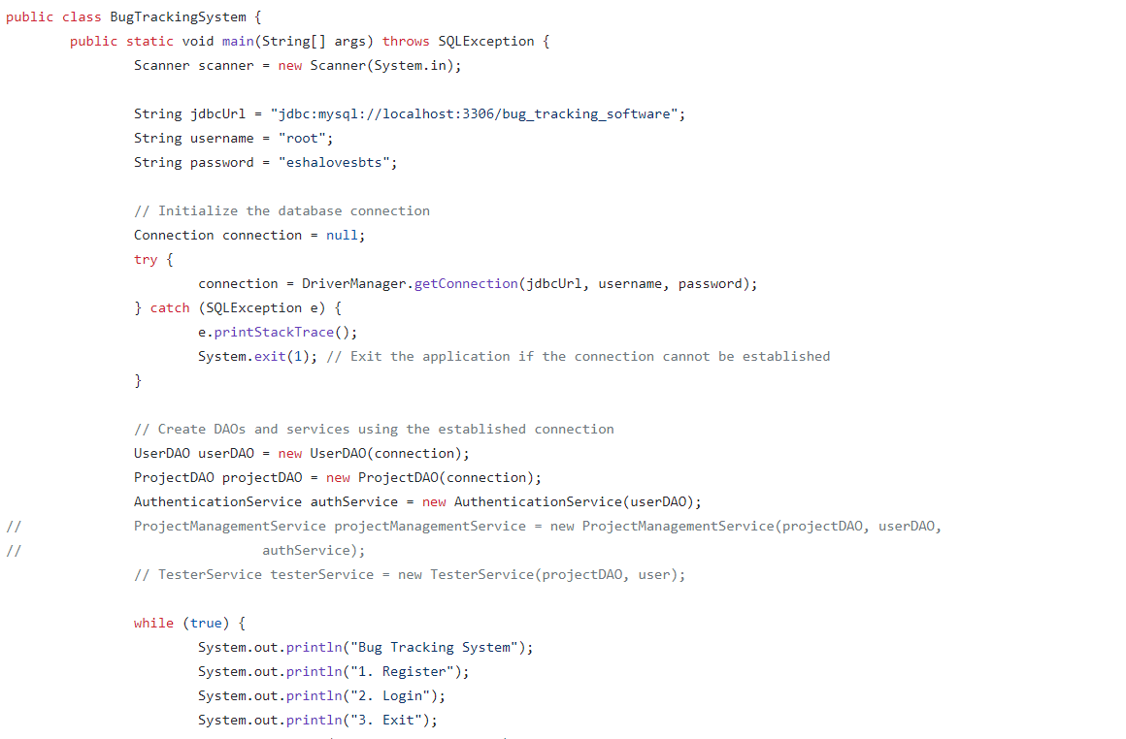

Slide 35
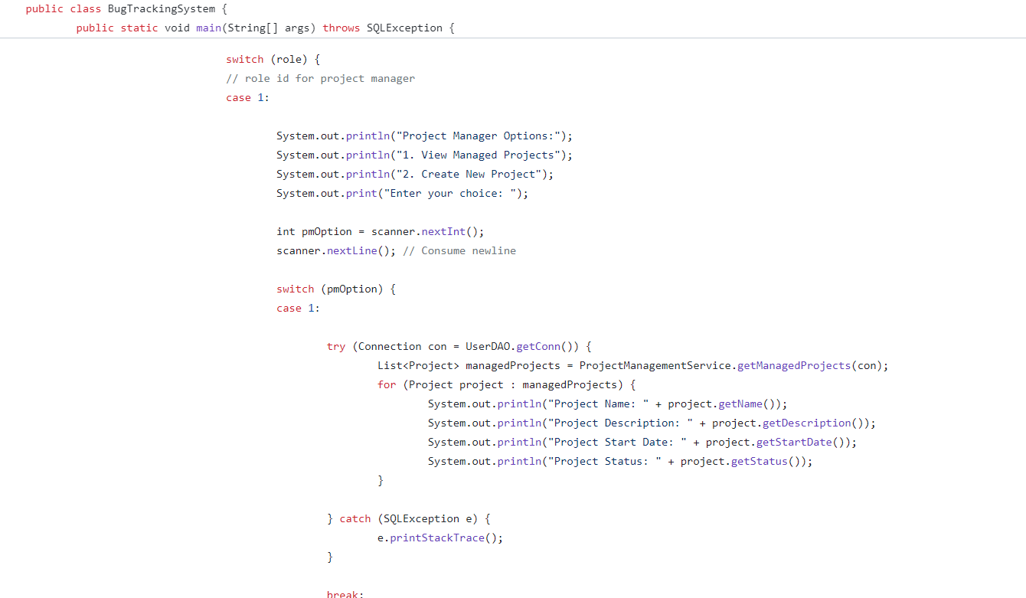

Slide 36
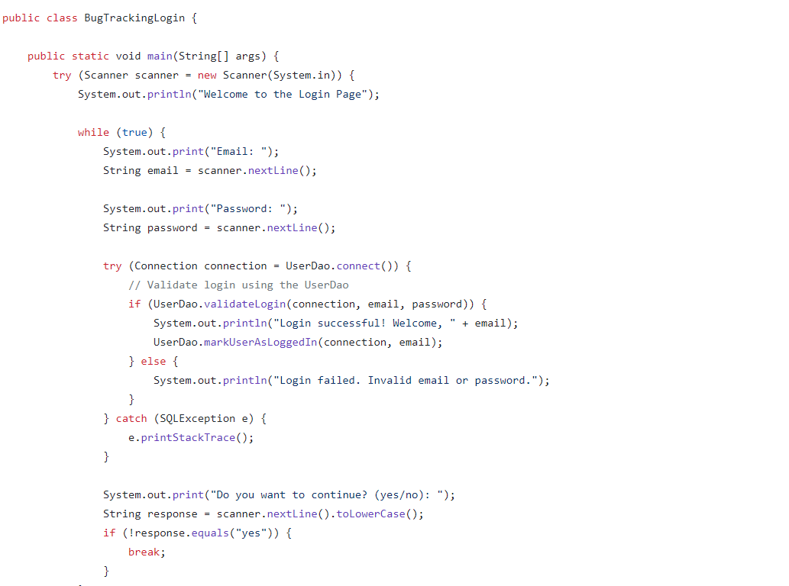

Slide 37
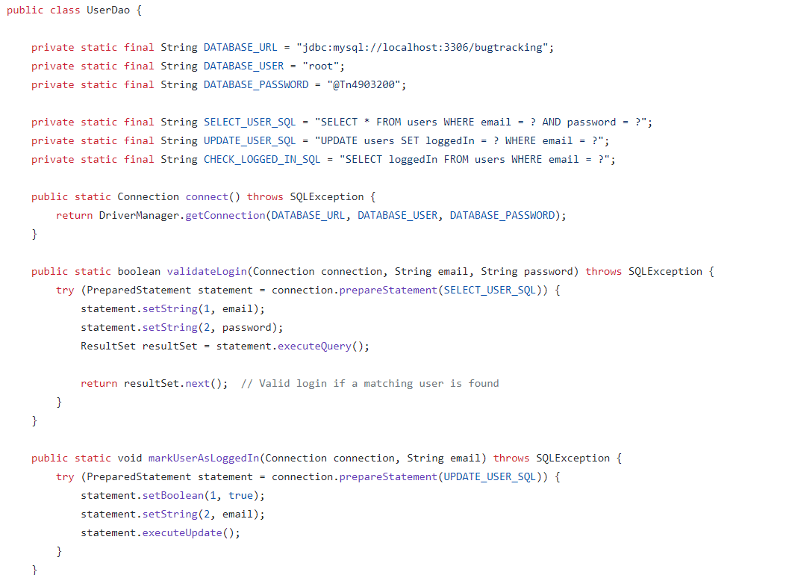

Slide 38
APPLICATIONS OF PROJECT
Bug tracking systems have a wide range of applications beyond traditional software development and testing. They can improve the quality, efficiency, and reliability of products and services in various industries by systematically identifying, prioritizing, and resolving issues and defects.

Slide 39




SOFTWARE DEVELOPMENT
Software Quality
The primary application is tracking and managing software defects (bugs) throughout the development lifecycle. It helps ensure that software products are released with fewer defects and meet quality standards.
Website Maintenance
Bug tracking systems help web developers identify and resolve issues related to website functionality, usability, and design. Also provides Cross-Browser Compatibility. Ensuring that websites work seamlessly across different web browsers and platforms.
Code Improvement
Developers use bug tracking systems to identify and prioritize code enhancements and optimizations in addition to fixing defects and to report and fix issues related to app functionality, performance, and compatibility with various devices and operating systems.

Slide 40


GAME DEVELOPMENT
Quality Assurance
Game developers use bug-tracking systems to track and fix issues related to gameplay, graphics, audio, and other aspects of the gaming experience.
Multiplayer and Network Issues
In online multiplayer games, bug tracking helps identify and resolve connectivity issues, latency problems, and synchronization errors.

Slide 41

Healthcare and Medical Devices
Bug tracking systems play a role in testing and ensuring the reliability and safety of medical software and devices, including electronic health records (EHRs) and diagnostic tools.
Bug tracking systems in the medical field are versatile tools that enhance patient safety, quality of care, regulatory compliance, and incident management. They facilitate proactive monitoring, reporting, and resolution of issues, contributing to improved patient outcomes and operational efficiency in healthcare settings.

Slide 42

Training and Education
Bug tracking systems can be adapted and applied in the educational field to enhance various aspects of educational administration, support, and management. While the term "bug" is traditionally associated with software defects, in the context of education, it refers to any issues, concerns, or tasks that need tracking, resolution, or improvement.
These systems promote efficiency, accountability, and responsiveness, contributing to a positive educational experience for students, faculty, and staff.

Slide 43


